Slide 1
MBA201
Module-3
Recruitment and Selection: Importance of Recruitment, Recruitment Policies,
Factors influencing Recruitment,
Recruitment Process, Sources,
Evaluation of Recruitment Process, Recruitment Strategy, Future Trends in Recruitment;
Selection Process; Selection Tests; Factors Influencing Selections. Significance of recruitment in human capital management.
Placement, Induction and Orientation.

Slide 2

It is a positive act since it attempts to encourage potential applicants to seek jobs in the firm.
It is not a single task; rather, it involves a series of planned activities.
It represents the first contact that an organization has with its potential employees.
It proposes to develop an applicant pool in the desired hiring ratio (the number of applicants for a job) to ensure an effective selection procedure..

Slide 3
It aims to discover and determine the sources of manpower to be utilized in tune with the strategic goals of the organization.
It intends to locate and reach out to the potential applicants, wherever they are, and offers an incentive to stimulate them to apply for the vacancies offered.
It is a function that calls for continued contact between the organization and the community as the latter makes the requisite human resources available to the former.

Slide 4

It is the process of attracting capable applicants for employment.
The process begins when new recruits are sought and ends when their applications are submitted. The result is a pool of applicants from which new employees are selected.
Recruitment is a process of searching for prospective employees and stimulating them to apply for jobs in the organization.

Slide 5

In the words of Flippo, “Recruitment is the process of searching for prospective employees and stimulating and encouraging them to apply for jobs in the organisation.
According to Dale Yoder, “Recruitment is a process to discover the sources of manpower to meet the requirement of the staffing schedule and to employ effective measures for attracting that manpower in adequate numbers to facilitate effective selection of an efficient working force.

Slide 6
Prospecting theory: Locating and encouraging potential applicants to apply for existing or anticipated job openings.
Recruiting large number of qualified applicants ready to take up job if offered.
Offering enough information to unqualified persons to self-select themselves out.
Creating positive image of the firm.
- Fit between organizational recruitment effort and a candidates job search effort.

Slide 7

Recruitment policy is the guiding principle that governs the HR practices relating to recruitment. It provides a broad framework for the HR department to choose its priorities relating to recruitment.
A methodical recruitment policy can ensure the availability of suitable persons at the appropriate time with the least disturbance to the production schedule

Slide 8

A good recruitment policy should be in conformity with the relevant public policy and legislations.
It should supplement the HR policies of the organization. In other words, it must not contravene the provisions of the general personnel policies.
It must display enough dynamism and progressiveness in its approach to attract the best talents for the organization.

Slide 9
It must constantly strive to make the necessary human resources available to match the skills requirement of the organization.
It should ensure equal employment opportunities for all sections of the society.

Slide 10

Retirement
Death
Resignation
Disability
Dismissal

Slide 11

Internal factors
Company’s Pay package
Quality of work life
Organizational culture
Career planning and growth
Role of trade unions
Cost of recruitment
Company size

Slide 12

Company’s products/services
Geographical spread of company’s operations
Company’s growth rate
Company’s name and fame
HR policy of the organization
Nature of the job
Reputation of the firm
Conventional wisdom

Slide 13
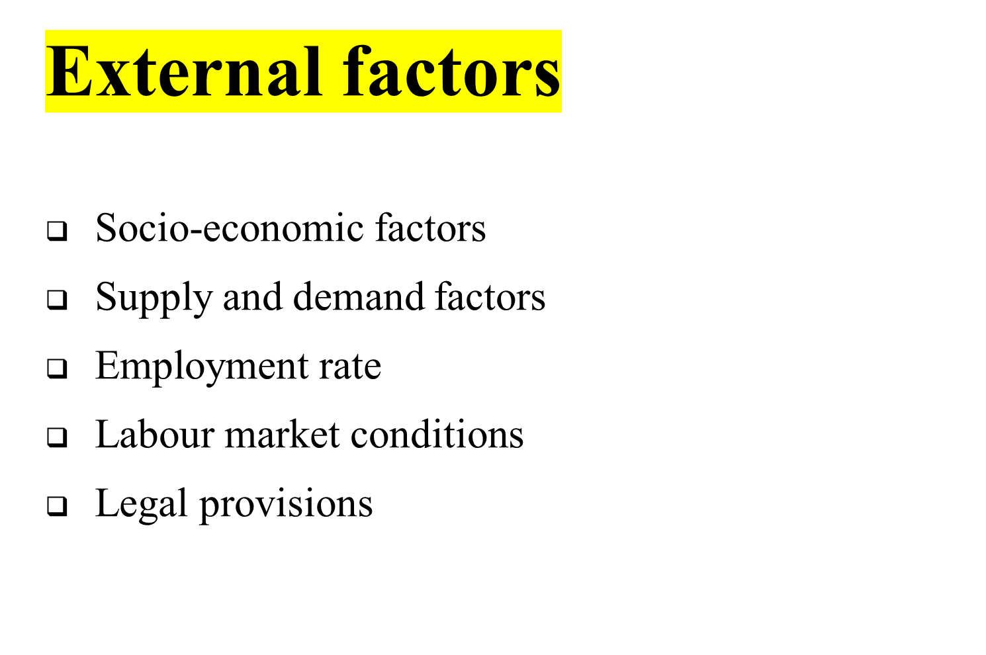

Slide 14

Human Resources Planning
Evaluation of the Sources of Recruitment
Implementation of Recruitment Methods and Strategies
Feedback and Control

Slide 15

Internal
  Present, Permanent employees
  Present, Temp/ Casual
  Retrenched / Retired
  Dependents of diseased , disabled , retired and present employees

Slide 16

Merits
1. Economical
2. Suitable
3. Reliable
4. Satisfying
Demerits
1. Limited choice
2. Inbreeding
3. Inefficiency
4. Bone of contention

Slide 17
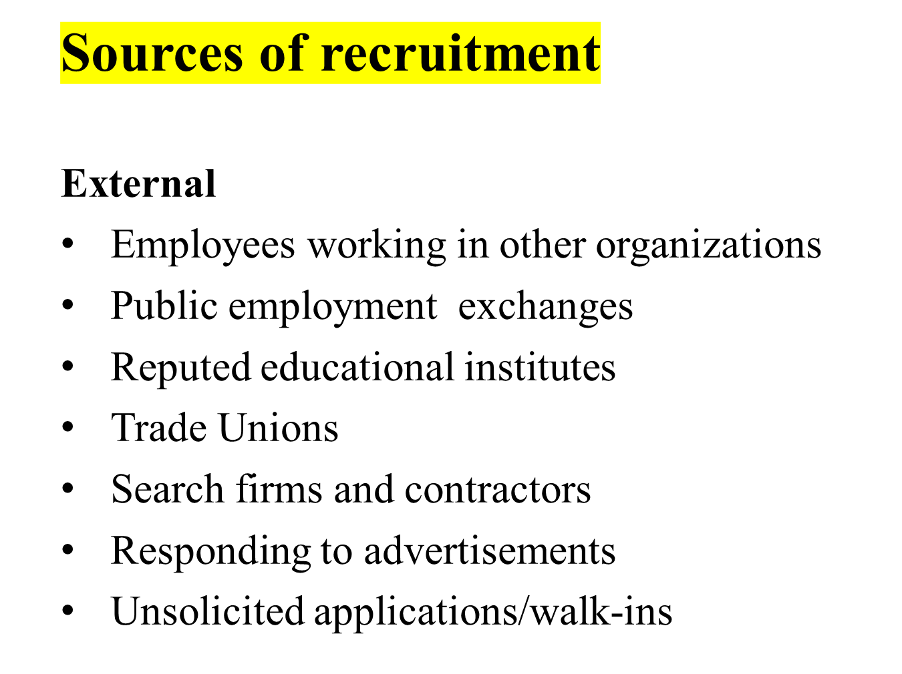

Slide 18


Slide 19

Merits
1. Wide choice
2. Injection of fresh blood
3. Motivational force
4. Long term benefits
Demerits
1. Expensive
2. Time consuming
3.Demotivating
4. Uncertainty

Slide 20

Internal Methods
1. Promotions and Transfers
2. Job Postings and Job Bidding
3. Employee Referrals
4. Employee Enlistment

Slide 21

Direct Methods
1.Campus Recruitment
- shortlist campuses
- Choose recruiting team carefully
- Pay smartly and not highly
- Present a clear image
- Do not oversell yourself
- Get in early
- Not everyone fits the bill

Slide 22

Indirect Methods
1.Newspaper ads
- Evaluate the pros and cons
- Right medium to get right stuff
- Lot of creativity entice people
2. Television and radio ads

Slide 23

Third party Methods
1. Private employment search firms
2. Employment exchanges
3. Gate hiring and Contractors
4. Unsolicited applicants/ walk-ins
5. Internet recruiting

Slide 24

1. Identify vacancy
2. job description and person specification
3. Advertising the vacancies
4. Managing the response
5. Short-listing
6. Arranging interviews
7. Conducting interview and decision making

Slide 25
1. Recruitment Planning
2. Recruitment Strategy
3. Searching the Right Candidates
4. Screening/Shortlisting
5. Evaluation and Control

Slide 26

The effectiveness and the validity of the process and methods are assessed
Salaries to the Recruiters
Advertisements cost and other costs incurred in recruitment methods, i.e., agency fees.
Administrative expenses and Recruitment overheads
Overtime and Outstanding costs, while the vacancies remain unfilled.
Cost incurred in recruiting suitable candidates for the final selection process
Time spent by the Management and the Professionals in preparing job description, job specifications, and conducting interviews.

Slide 27
Cost, Time, Flexibility, Quality
Time Lapse Data
Yield Ratio’s

Slide 28

While preparing a recruitment strategy, the HR team considers the following points:
Make or buy employees
Types of recruitment
Geographical area
Recruitment sources

Slide 29
The steps involved in developing a recruitment strategy include:
Setting up a board team
Analyzing HR strategy
Collection of available data
Analyzing the collected data
Setting the recruitment strategy

Slide 30

Outsourcing
Poaching/Raiding
E-Recruitment

Slide 31

To choose
Selection is the process of picking individuals who have relevant qualification to fill jobs in an organization.
The basic purpose is to choose the individual who can most successfully performs the job, from the pool of qualified candidates

Slide 32

Selection, as the name implies, involves picking and hiring a few people from the total number of candidates applying for the sales job.
Selection is done by comparing the requirements of a job with the applicant’s qualifications.
The following are, some common steps in any selection process:

Slide 33
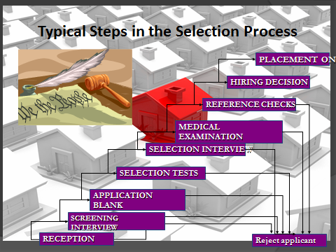

Slide 34

Reception: A Company is known by people it employs
KSA
Creating a impression
Courteous, Tactful, honesty, clearly.
Meet HR

Slide 35

The purpose of preliminary interviews is basically to eliminate unqualified applications based on information supplied in application forms.
• The basic objective is to reject misfits. On the other hands preliminary interviews is often called a courtesy interview and is a good public relations exercise.
• Courtesy interview-screen out obvious misfit

Slide 36

Collect information on various aspects of the applicants academic, social, demographic, work related background and reference
Personal data
Extracurricular activities
Marital data references
Physical data
Educational data
Employment data

Slide 37

Job seekers who pass the preliminary interviews are called for tests.
There are various types of tests conducted depending upon the jobs and the company.
A test is a standardized, objective measure of a persons behaviour, performance or attitude

Slide 38

Intelligence test, Aptitude Tests,
Personality Tests,(Projective tests, Interest tests, Preference tests),
Achievement tests, Simulation tests,
Assessment center and Ability Tests
and are conducted to judge how well an individual can perform tasks related to the job.
Besides this there are some other tests also like
Interest Tests (activity preferences), Graphology Test (Handwriting),
Medical Tests, Psychometric Tests, Polygraph, Integrity test, etc.

Slide 39

The next step in selection is employment interview. Here interview is a formal and in-depth conversation between applicant’s acceptability.
It is considered to be an excellent selection device. Interviews can be One-to-One, Panel Interview, or Sequential Interviews. Besides there can be Structured and Unstructured interviews, Behavioral Interviews, Stress Interviews. \
Types of Interview
The non directive interview, The directive or structured interview
The situational interview, The behavioral interview
Stress interview, Panel interview

Slide 40

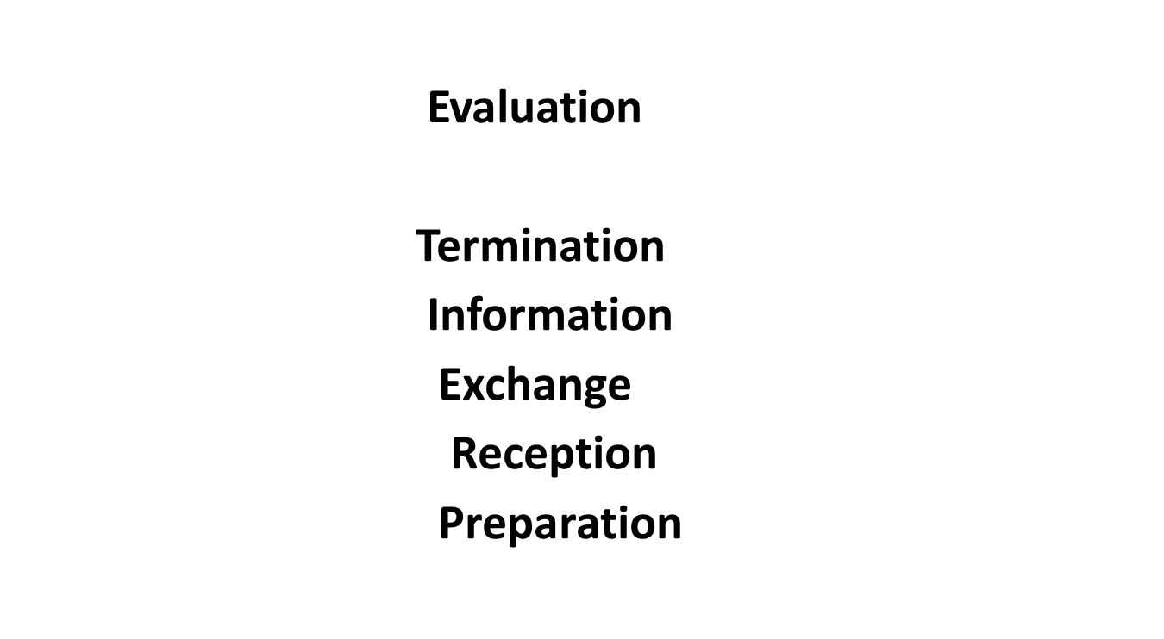

Slide 41

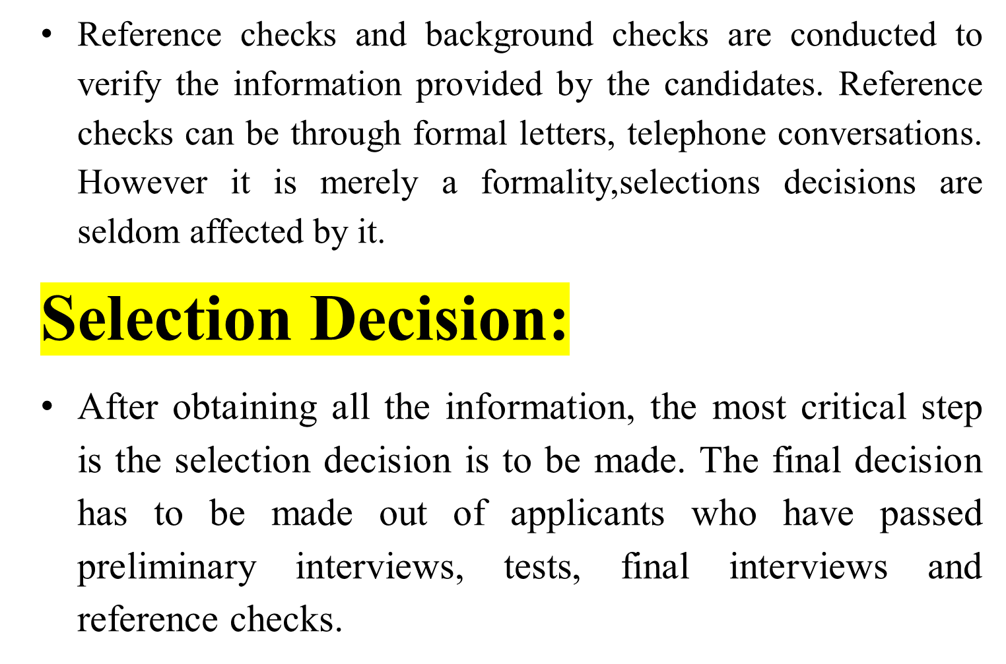

Slide 42

True positive
True negative
False positive error
False negative error
False positive error

Slide 43

Cost incurred while the person is employed, and this is the result of production or profit losses, damaged company reputation, accidents due to negligence, absenteeism and the like.
Costs associated with the training, transfer or terminating the services of the employee.
Costs of replacing generally the more important the job, the greater the cost of the selection.

Slide 44

1. In this type an applicant who would have succeeded is rejected because of predicted failure.
2. Cost difficult to estimate
Physical Examination: After the selection decision is made, the candidate is required to undergo a physical fitness test. A job offer is often contingent upon the candidate passing the physical examination.
Job Offer: The next step in selection process is job offer to those applicants who have crossed all the previous hurdles. It is made by way of letter of appointment.
Contract of Employment: After the job offer is made and candidates accept the offer, certain documents need to be executed by the employer and the candidate. Here is a need to prepare a formal contract of employment, containing written contractual terms of employment etc.

Slide 45

Whether the applicant is medically suitable for the specific job or not.
Whether the applicant has health problems or psychological attitudes likely to interfere with work efficiency or future attendance.
Whether the applicant suffers from bad health which should be corrected before he can work satisfactorily.
Whether the applicant’s physical measurements are in accordance with job requirements or not.

Slide 46
It shortlists the candidates by matching the candidate’s qualifications, skills, etc with those of skills and the right competencies inbuilt in the software
It also prepares interview schedules and communicates the same to the candidates
It streamlines the entire recruitment process for a given time and unlimited job recruitments
The number of people required for handling of applications are reduced drastically

Slide 47

1. Phone call and further clarification
2. Letter of intent
3. Completing employment forms
4. Protocols may be available for intetested individuals
5. Number of candidates
6. Names, surenames and adresses of 5 top candidates
7. Recruitment and selection criteria
8. Justification of the decision

Slide 48
Reception
Screening Interview
Application Blank-- Weighted Application Blanks
1. Selection Testing
2. Intelligence tests
3. Aptitude tests
4. Personality tests-projective tests, Interest tests, Preference tests
4. Achievement tests
5. Simulation tests
6. Assessment centre
a. The in-basket
b. The leaderless group discussion

Slide 49
b. The leaderless group discussion
c. Business games
d. Individual presentation
e. Structured Interview
Evaluation of Assessment centre
7. Graphology tests
8. Polygraph tests ( Lie- detector)
9. Integrity tests
Selection Interview
Medical examination
Reference checks
Hiring Decision

Slide 50

